Slide 1
March Meeting
Team Meeting & Camp Rapid Building 450
6-11-2024 10:00 AM

Slide 2
Agenda
10:00 AM Call Meeting to Order-
Roll Call of Members- Secretary
Additional Items to be added to agenda – T-Mobile will not be presenting & Spearfish mobile coverage challenges
Approve meeting minutes of March meeting
Organizations
Police Chiefs Assn. – Jason Jones
Sheriff’s Assn – Steve Swenson
DCI/Attorney General – Chad Mosteller
GFP – Bruce Nachtigall
DOT – Brian Wacholz
National Guard – David Goodwin
Emergency Managers – Pat Harrington
Firefighters – Charlie Kludt
Healthcare – Tim Rave
Highway Patrol – Garrett Wellman
APCO/NENA – Kevin Karley
EMT – Brent Long
Wildland Fire – Ray Black
County Commissioners – Kade Haley
Health Department – Chuck Kevghas
Tribal Governments – Jim Pearson
Federal Government – Andy Barth
BIT Engineering – Trent Nincehelser
SD Senate – John Wiik
SD House of Representatives – David Kull
911 – Jason Husby

Slide 3
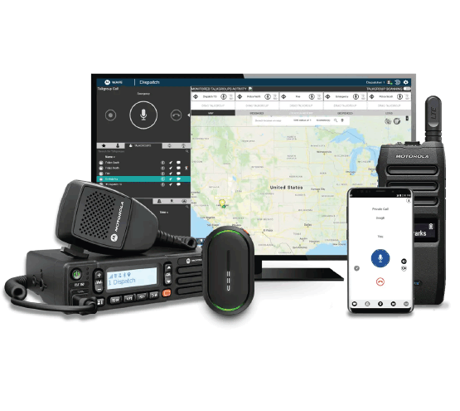
New Business
1. SWIC Updates – Todd Dravland (SWIC South Dakota)
2. System Upgrade Status – Completed
Update state radio core software version in July
System Cleanup/unused radios post project – deleted approximately 10,000 radio IDs from system
Smart Connect–Identifying standards for Wi-Fi and LTE interoperability with RF and setting RSSI thresholds
SmartConnect template
Responder SSID – working with Avera to add

Slide 4
New Business (continued)
3. Radio Programming challenges
Consider changes to ASK qualifications for out of state vendors
Continue to seek programming volunteers within your organizations
Vendor/Volunteer Radio Training Class for SD template – Cost per person likely 3–4-day class
Monthly town hall style meetings for volunteers with State Radio staff
RF programmer forum
4. State Radio Redundant Core Solution – Review underserved formula
5. RoIP policy

Slide 5
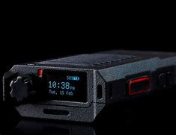
New Business (continued)
6. Review of State Radio Technical Innovation
Currently testing Siyata SD7
State Radio staff completed RadioSoft RadioCompass training
5 State Radio team members training for FAA Part 107 license for drone pilot
River Cities Transit using Critical Connect Dispatch now
7. I90 Corridor update
$46,000 funding appropriated to state radio for radio coverage study
Working with RFCC Communications Consulting
Initial scope of work defined
Determine next steps pending study results
8. Minnehaha County projects update
North Minnehaha simulcast
Successfully moved VA subsite to Menlo Park in May 2024

Slide 6
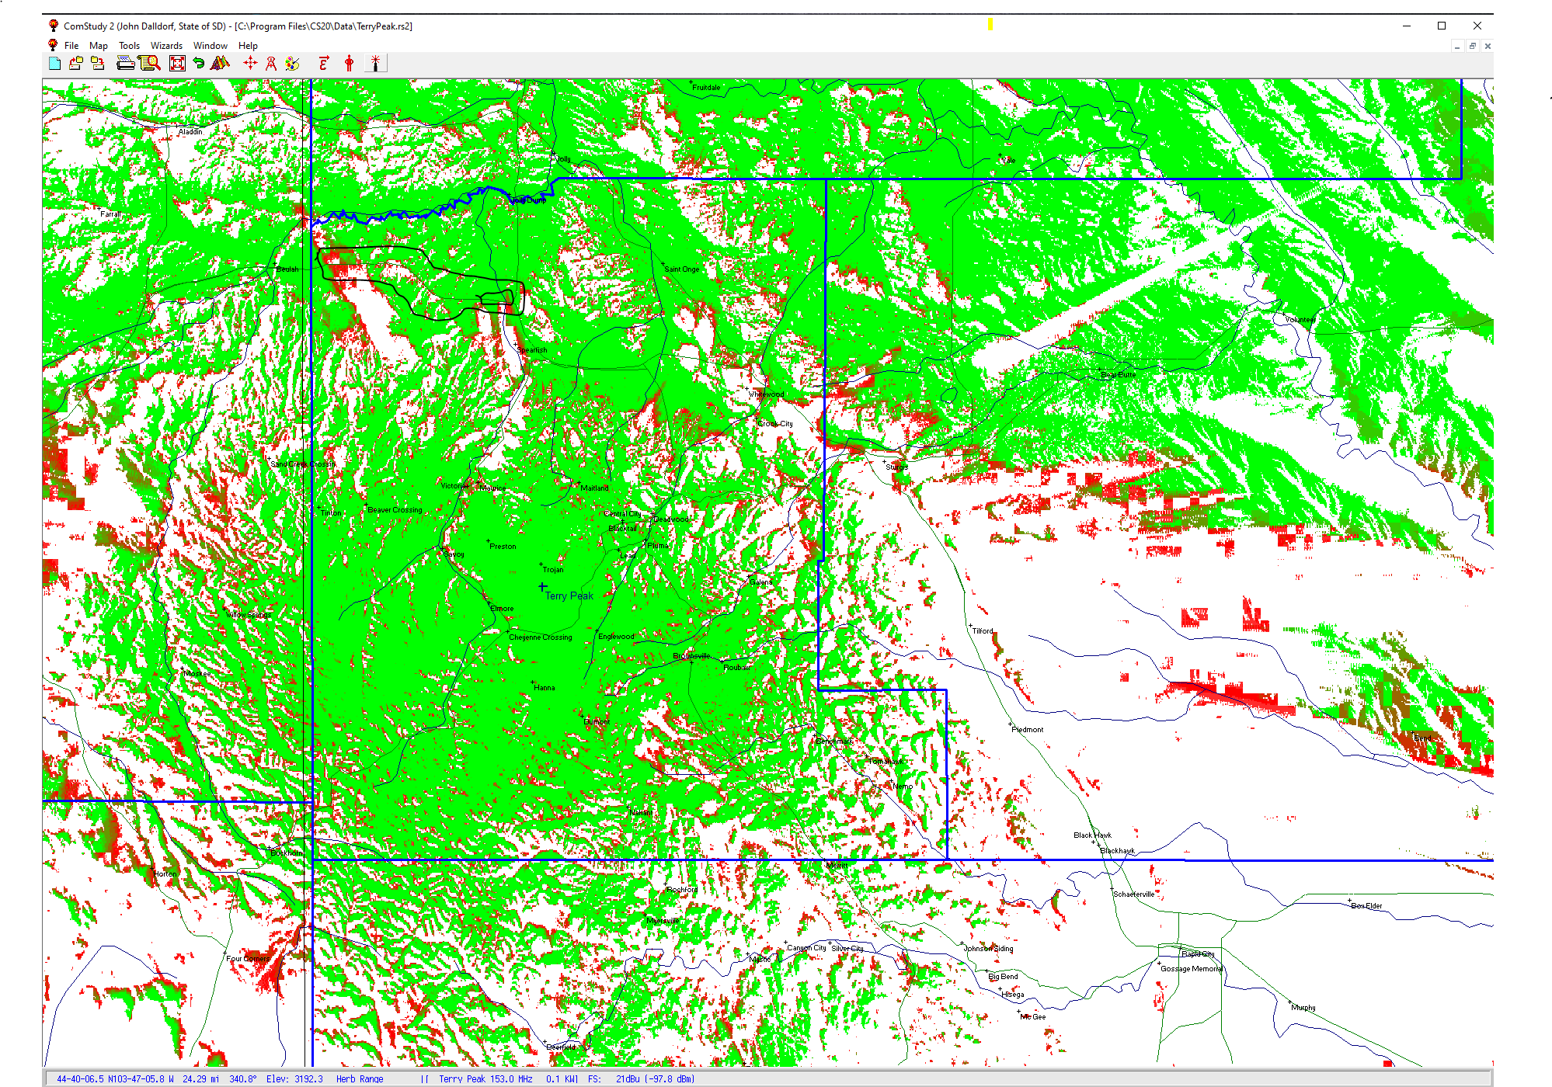
New Business (Continued)
9. Spearfish I90 Corridor coverage challenges
Mobile radio coverage issues reported by SDHP
RadioSoft Mapping represents the area of coverage challenges
High noise floor at Terry Peak site causes degradation
SDPB site we can leverage for new tower site location with added benefit of portable coverage in Spearfish

Slide 7
Old Business
Budget
Nearly 22% of total operational budget is paid in July for annual Motorola support contract
9% Personnel and 16% of Operational funds available

Slide 8
Old Business (Continued)
2. Broadband Subcommittee Report – Kendall Light
FirstNet Buildout Updates– Doug Penniston
3. T-Mobile Presentation- Cancelled
4. Organization Representative Vacancies
John Wiik 6/30/2024
Officer election today

Slide 9
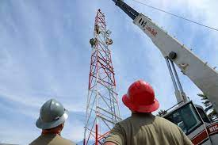
Old Business (Continued)
5 Year plan
Year 2024 | Identify, champion, and promote sustainable funding for State radio system. Broadband subcommittee does formal evaluation of public safety apps and make recommendation. Examine capabilities of Critical Connect/Smart Connect for cross-border solution. Identify and request funding to build expansion sites as authorized for improved mobile coverage. Form subcommittee to look at PSAP direct -connect options work with 911 coordinator. Investigate potential for remote radio management in South Dakota. Champion/Recommend redundant core solution for BIT Commissioner to address in 2025 legislation. Form subcommittee to create policy for RoIP solutions. Promote volunteer radio programmers in South Dakota.
Year 2025 | Full-scale review of industry technology and trends relating to Public Safety Draft any changes/recommendations for BIT Commissioner to address in 2026 legislative session. Review SDPSCC website and modernize. 2 council members attend APCO or IWCE national conference. Review of wireless carrier capabilities & recommend improvements. Review & recommend PSAP/dispatch improvements related to LMR system & applications.
Year 2026 | Propose recommendation from industry review in conjunction with 2025 review. Recommend expansion sites as needed. 2 council members attend APCO or IWCE national conference. Full review of council by-laws, membership, and structure Standardized recommendation for CAD services across the State of South Dakota Full review of COMU program
Year 2027 | TBD
Year 2028 | TBD
4. 5 Year Plan Review
Identify and list objectives for years 2027 and 2028
Seeking input from SDPSCC

Slide 10
Organizational Reports
Organization Reports
Police Chiefs Assn. – Jason Jones
Sheriff’s Assn – Steve Swenson
DCI/Attorney General – Chad Mosteller
GFP – Bruce Nachtigall
DOT – Brian Wacholz
National Guard – David Goodwin
Emergency Managers – Pat Harrington
Firefighters – Charlie Kludt
Healthcare – Tim Rave
Highway Patrol – Garrett Wellman
APCO/NENA – Kevin Karley
EMT – Brent Long
Wildland Fire – Ray Black
County Commissioners – Kade Haley
Health Department – Chuck Kevghas
Tribal Governments – Jim Pearson
Federal Government – Andy Barth
BIT Engineering – Trent Nincehelser
SD Senate – John Wiik
SD House of Representatives – David Kull
911 – Jason Husby
Closing Comments
Vice-chair – Garrett Wellman
Member at Large - Kevin Karley
Chair – Bruce Nachtigall
Next Meeting: date, time, location

